Slide 1
UNIT 0
GETTING STARTED
WHAT’S INCLUDED
YOU ARE HERE
INTRODUCING SCRATCH 10
SCRATCH ACCOUNT 12
DESIGN JOURNAL 14
SCRATCH SURPRISE 16
SCRATCH STUDIO 18
CRITIQUE GROUP 20
0
1
2
3
4
5
6
7
Notes:
<numéro>

Slide 2
UNIT 0
OVERVIEW
THE “BIG IDEA”
When we shared a draft of this guide with teachers, a common initial reaction was, “Unit 0?!? Why 0?”
We hoped to communicate that this is a preparatory unit, supporting you in establishing a culture of creative computing through creating, personalizing, sharing, and reflecting. Our ambition to support this type of learning culture will be evident throughout the guide.
Creative computing culture has an intellectual dimension, engaging with a set of computational concepts and practices. It has a physical dimension, encouraging interactions with others through the placement of desks, chairs, and computers. Most importantly, it has an affective dimension, cultivating a sense of confidence and fearlessness.
It really helps if you have kind of a culture or climate in your classroom. It starts on the first day – getting kids to appreciate that they’re going to make mistakes and that I’m going to be asking them to do stuff that is hard. I always just put that right out there. And they don’t, at first, just because they want to succeed. Even adults don’t like to fail, or make mistakes. But it is important, I feel, that when you do run into difficulties that it’s not time to give up or cry. It’s time to think about the strategies that you have to solve your problem, or to look for help. No reason to break down or give up – you keep at it.
TS, Elementary School Teacher
LEARNING OBJECTIVES
KEY WORDS, CONCEPTS, & PRACTICES
Students will:
be introduced to the concept of computational creation, in the context of Scratch
be able to imagine possibilities for their own Scratch-based computational creation
become familiar with resources that support their computational creation
prepare for creating Scratch projects by establishing Scratch accounts, exploring Scratch studios, creating design journals, and organizing critique groups
profile editor
project page
studio
critique croup
red, yellow, green
NOTES
Coordinate with your IT department to make sure your computers can access the Scratch website.
Don’t have internet access? An offline version of Scratch is available for download: http://scratch.mit.edu/scratch2download
8
Notes:
<numéro>

Slide 3
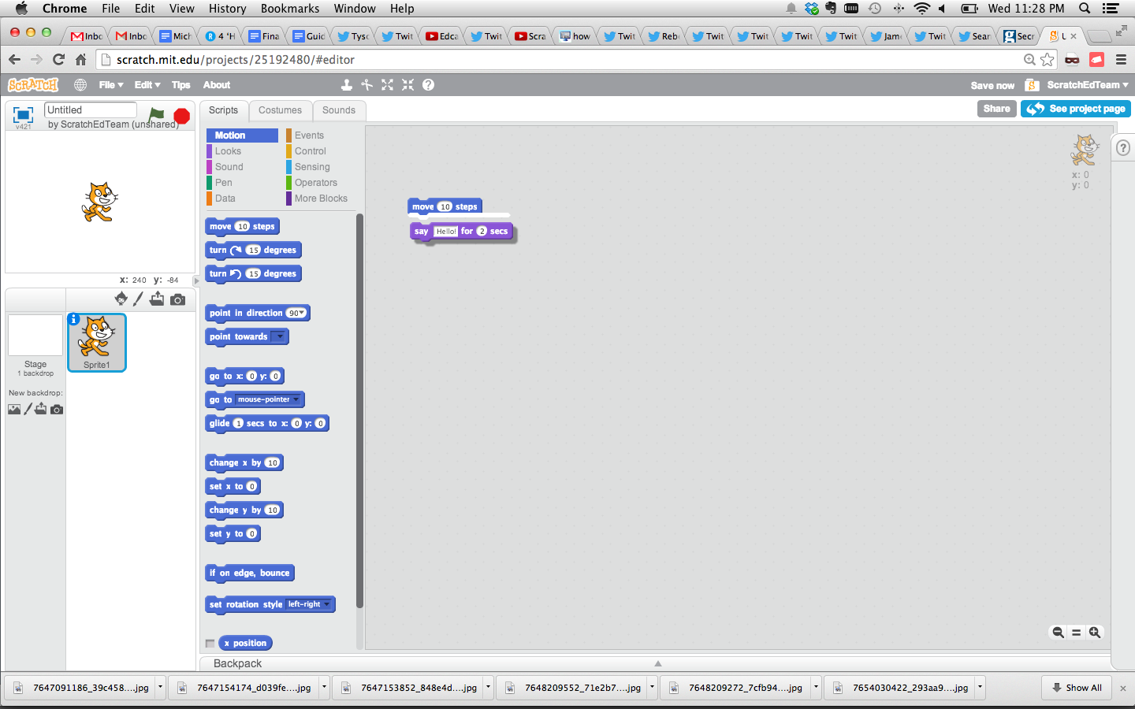
CHOOSE YOUR OWN ADVENTURE
Ready to get started? This unit is designed for those who are completely new to Scratch. From exploring inspiring projects, to creating a Scratch account, to having an initial experience playing with the Scratch project editor, each activity is designed to guide you and your students through the process of getting started with Scratch.
In each unit, we offer a selection of activities – but we encourage you to tinker with the choice and order of the activities. Different contexts and audiences will invite different experiences. Choose your own adventure by mixing and matching the activities in ways that are most compelling for you and the learners you support.
Not sure where to start? For more support, check out the suggested path through the activities provided below.
POSSIBLE PATH
SESSION 1
SESSION 2
INTRODUCING SCRATCH
SCRATCH ACCOUNT
DESIGN JOURNAL
SCRATCH SURPRISE
SCRATCH STUDIO
CRITIQUE GROUP
Watch the Scratch overview video and imagine what’s possible with Scratch.
Set up a Scratch account to save and share your projects.
Create a design journal to write down notes and reflections on the process of designing Scratch projects.
Can you make the Scratch cat do something surprising?
Learn how to create a studio and add a project to the studio.
Gather in small peer groups to give and receive feedback on ideas and projects drafts.
9

Slide 4


INTRODUCING SCRATCH
OBJECTIVES
By completing this activity, students will:
be introduced to computational creation with the Scratch programming environment by watching the Scratch overview video or exploring sample projects
be able to imagine possibilities for their own Scratch-based computational creation
UNIT 0 ACTIVITY
_{SUGGESTED TIME}
5–15 MINUTES
ACTIVITY DESCRIPTION
RESOURCES
Ask students about their experiences with computers using the reflection prompts to the right.
Introduce students to creative computing with Scratch and the range of projects they will be able to create by showing the Scratch overview video and some sample projects that your students will find engaging and inspiring. Explain that over the next several sessions they will be creating their own interactive computational media with Scratch.
What will you create? Ask students to imagine what types of projects they want to create with Scratch.
projector for showing Scratch overview video (optional)
Scratch overview video http://vimeo.com/65583694 http://youtu.be/-SjuiawRMU4
sample projects studio http://scratch.mit.edu/studios/137903
REFLECTION PROMPTS
What are the different ways you interact with computers?
How many of those ways involve being creative with computers?
REVIEWING STUDENT WORK
Did students brainstorm a diverse range of project ideas? If not, try showing a wide variety of projects to give students a sense of the possibilities.
NOTES
NOTES TO SELF
If you don’t have internet access, download the Scratch overview video from Vimeo before class, available at http://vimeo.com/65583694
Instead of writing out their answers to the reflections prompts, encourage students to get creative by drawing their responses. (e.g., “Draw different ways you interact with computers.”)
10
Notes:
<numéro>

Slide 5
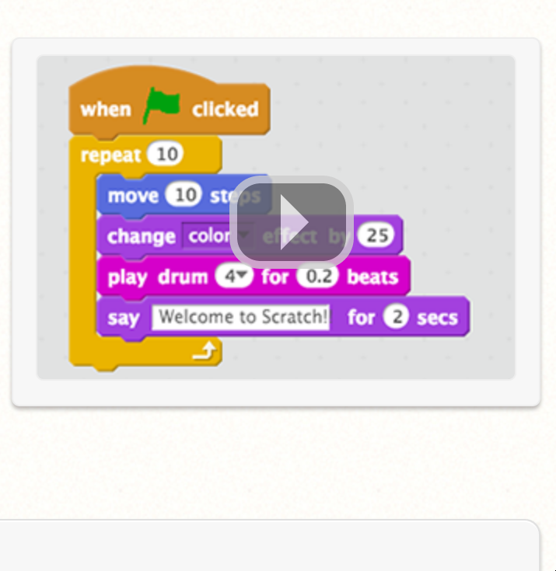
Notes:
<numéro>

Slide 6
SCRATCH ACCOUNT
OBJECTIVES
By completing this activity, students will:
create a Scratch account
explore the Scratch online community and review the Scratch community guidelines
UNIT 0 ACTIVITY
_{SUGGESTED TIME}
5–15 MINUTES
ACTIVITY DESCRIPTION
RESOURCES
Scratch online accounts require an email address. If students cannot provide a personal or school email address, a teacher or parent/guardian email address may be used. Plan in advance if permission slips for online accounts need to be collected.
Help students navigate to the Scratch website at http://scratch.mit.edu and click on “Join Scratch” to get started creating a Scratch account. Optionally, have the Scratch Account handout available to guide students. Give students time to register, update their Scratch profile page, and explore the Scratch online community. Encourage students to practice signing in and out of their accounts.
To make it easier for members of the class to find and follow one another’s Scratch profiles, consider creating a class list of usernames and names.
Examine the Scratch community guidelines as a group to discuss respectful and constructive behavior. Review how to report inappropriate posts on the website.
Scratch Account handout
Scratch community guidelines http://scratch.mit.edu/community_guidelines
REFLECTION PROMPTS
What is your Scratch account username?
What is a hint to help you remember your password?
REVIEWING STUDENT WORK
Were students able to create Scratch accounts and successfully sign in and out of the Scratch website?
NOTES
NOTES TO SELF
Teachers may prefer providing their email or creating a class email address, as notifications of any inappropriate behavior on the Scratch website will be sent to the email that is registered with the account.
Check if any students already have an online account.
To remember passwords while maintaining privacy, have students write down their username and password in sealed envelopes that are kept in a secure place in the classroom.
12
Notes:
<numéro>

Slide 7

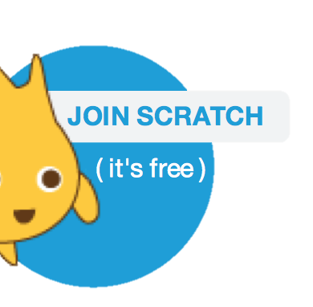
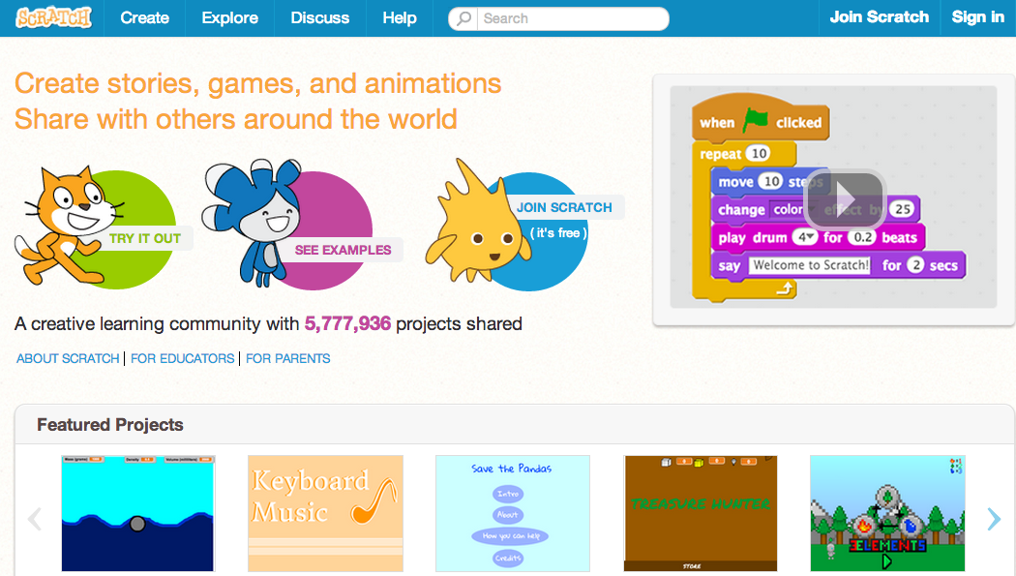
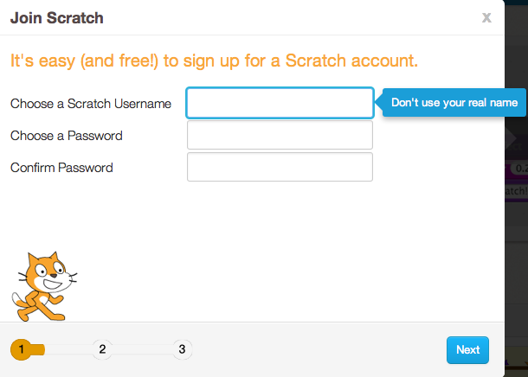
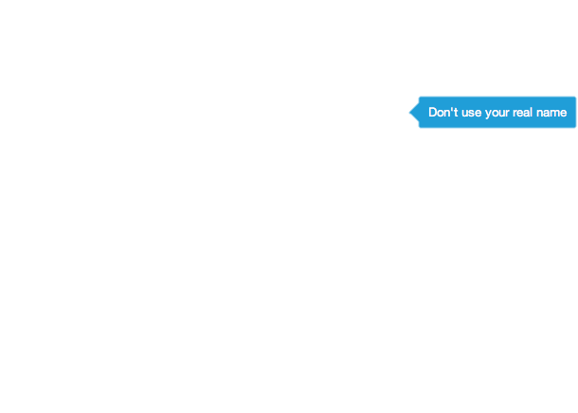
SCRATCH ACCOUNT
NEW TO SCRATCH? GET STARTED BY CREATING YOUR SCRATCH ACCOUNT!
You will need a Scratch account to create, save, and share your Scratch projects. The steps below will walk you through creating a new account and setting up your profile.
START HERE
Open a web browser and navigate to the Scratch website: http://scratch.mit.edu
On the homepage, click on “Join Scratch” at the top on the right or in the blue circle.
Complete the three steps to sign up for your very own Scratch account!
FINISHED?
FINISHED?
Notes:
<numéro>

Slide 8

DESIGN JOURNAL
OBJECTIVES
By completing this activity, students will:
start a personalized design journal for documenting their design process and reflections
UNIT 0 ACTIVITY
_{SUGGESTED TIME}
15–30 MINUTES
ACTIVITY DESCRIPTION
ACTIVITY DESCRIPTION
RESOURCES
Introduce students to the idea of the design journal, a physical or digital notebook where they can brainstorm ideas and share personal reflections, similar to a personal journal or diary. Explain that students will be prompted to update their design journals throughout their Scratch programming adventures, but encourage them to add to their journals anytime during the process of designing projects to capture ideas, inspiration, notes, sketches, questions, frustrations, triumphs, etc.
Look through sample design journals to get ideas for what type of design journals (paper or digital) will work best for your students. Give students time to start and personalize their design journals.
Ask students to create their first design journal post by responding to the reflection prompts on the right.
Encourage students to share their design journals and initial reflections with a neighbor.
sample design journals http://bit.ly/designjournal-paper http://bit.ly/designjournal-digital http://bit.ly/designjournal-blog
paper and craft materials (for paper journals)
REFLECTION PROMPTS
How would you describe Scratch to a friend?
Write or sketch ideas for three different Scratch projects you are interested in creating.
REVIEWING STUDENT WORK
What do the reflection responses tell you about the types of projects students might be interested in pursuing?
Based on students’ responses, which units in this guide might appeal to your different students?
NOTES
NOTES TO SELF
During other guide activities, facilitate group discussions around relevant reflection prompts.
Decide whether design journals should be private or public. For example, you could maintain one-on-one feedback with students through private journals or have students leave comments for peers on shared journals. Consider the pros and cons of each option.
14
Notes:
<numéro>

Slide 9
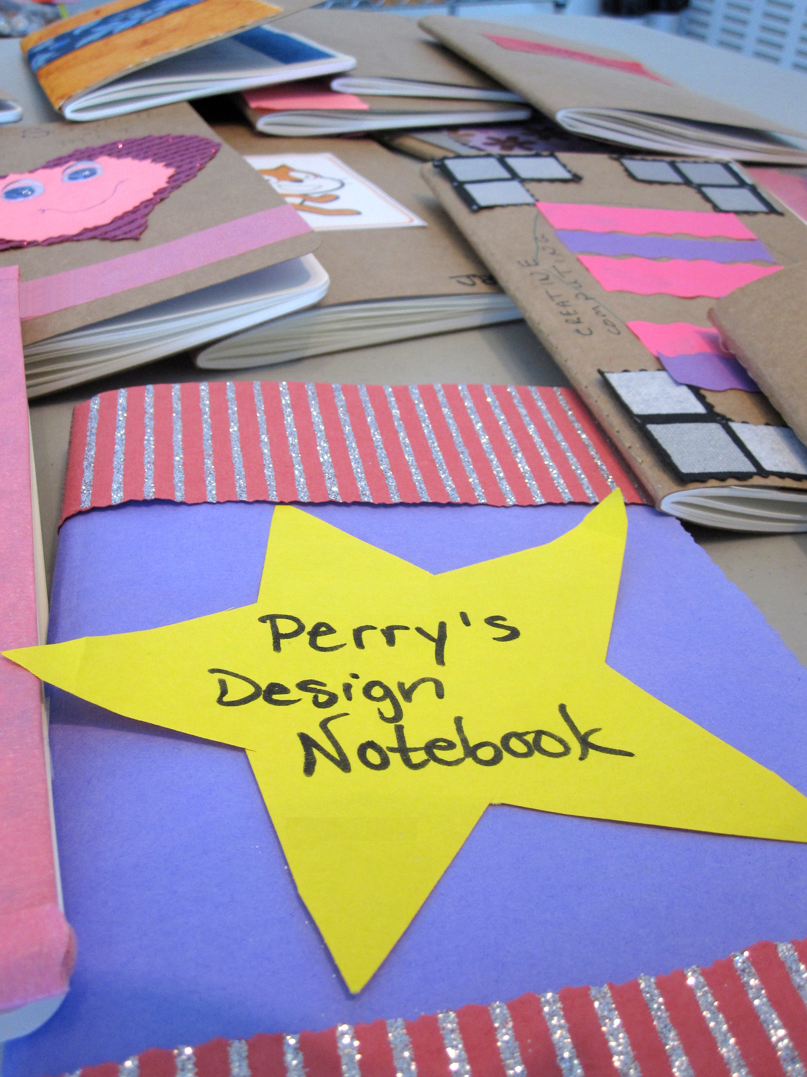
Notes:
<numéro>

Slide 10
SCRATCH SURPRISE
OBJECTIVES
By completing this activity, students will:
engage in an exploratory, hands-on experience with Scratch
UIT 0 ACTIVITY
UNIT 0 ACTIVITY
_{SUGGESTED TIME}
15–30 MINUTES
ACTIVITY DESCRIPTION
RESOURCES
Help students open the Scratch project editor by navigating to the Scratch website at http://scratch.mit.edu, signing in to their Scratch accounts, and then clicking on “Create” at the top of the page. Optionally, have the Scratch Surprise handout and Scratch Cards available to guide students during their explorations.
Give students 10 minutes to explore the Scratch interface in an open-ended way. Prompt students with, “You have 10 minutes to make something surprising happen to the Scratch cat.” Or, “Take 10 minutes to explore the interface fearlessly. What do you notice?” Encourage students to work together, ask each other for help, and share what they are figuring out.
Ask for 3 or 4 volunteers to share with the entire group one thing that they discovered. Optionally, after the volunteers have shared, offer several challenges to the students: - Did anyone figure out how to add sound? - Did anyone figure out how to change the background? - Did anyone figure out how to get help with blocks?
Scratch Surprise Handout
Scratch Cards http://scratch.mit.edu/help/cards
REFLECTION PROMPTS
What did you figure out?
What do you want to know more about?
REVIEWING STUDENT WORK
Do students know how to initiate a new project?
Do students understand the basic mechanism of snapping Scratch blocks together?
NOTES
NOTES TO SELF
A major goal of this activity is to establish a culture of fearlessness, exploration, and peer collaboration. It is expected that students (and their teachers!) will not know everything ahead of time – and the environment becomes a space where everyone is learning together.
Make sure that your computers have the latest version of Flash to run Scratch: http://helpx.adobe.com/flash-player.html
16
Notes:
<numéro>

Slide 11
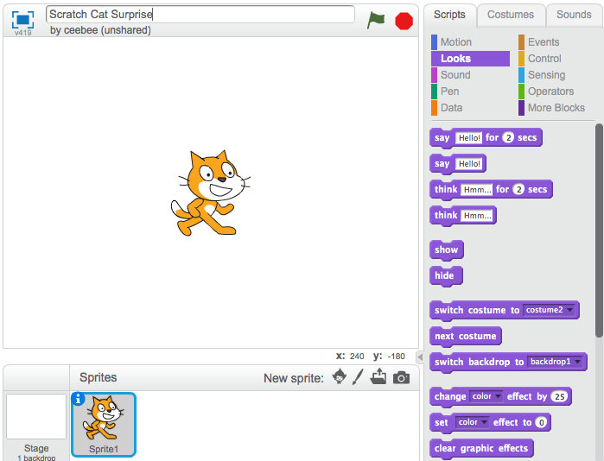
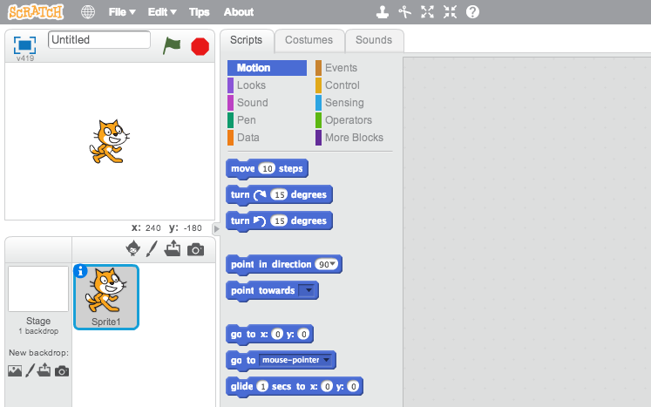
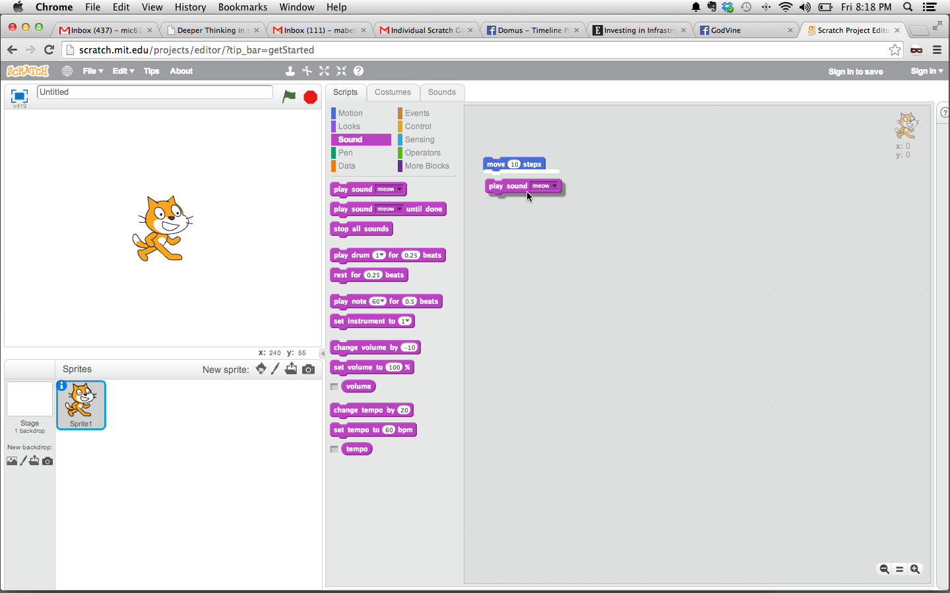
SCRATCH SURPRISE
CAN YOU MAKE THE SCRATCH CAT DO SOMETHING SURPRISING?
In this activity, you will create a new project with Scratch and explore different Scratch blocks to make the cat do something surprising! What will you create?
START HERE
Go to the Scratch website: http://scratch.mit.edu
Sign into your account.
Click on the “Create” tab located at the top left of the browser to start a new project.
Time to explore! Try clicking on different parts of the Scratch interface to see what happens.
Play with different Scratch blocks! Drag and drop Scratch blocks into the scripting area. Experiment by clicking on each block to see what they do or try snapping blocks together.
Notes:
<numéro>

Slide 12
SCRATCH STUDIO
OBJECTIVES
By completing this activity, students will:
be able to add a project to a studio
be able to post comments on other Scratch projects
UNIT 0 ACTIVITY
_{SUGGESTED TIME}
5–15 MINUTES
ACTIVITY DESCRIPTION
RESOURCES
Scratch studios are one way to collect and organize Scratch projects online. In this activity, help students understand what studios are and how to add a project to a studio. Optionally, have the Scratch Studio handout available to guide students.
First, have students navigate to the Scratch website and sign in to their accounts. Next, help students find the Scratch Surprise studio or a class studio you’ve created. Then, let students share their Scratch Surprise explorations with others by adding their programs to the studio.
Encourage students to investigate other projects in the studio. Invite them to add a comment on the project page of two projects in the collection that they find particularly interesting or inspiring. Engage the group in a discussion about how to give appropriate and purposeful feedback.
Ask students to think back on their creative explorations by responding to the reflection prompts in their design journals or in a group discussion.
Scratch Studio handout
Scratch Surprise studio http://scratch.mit.edu/studios/460431
REFLECTION PROMPTS
What are Scratch studios for?
What did you find interesting or inspiring about looking at other projects?
What two comments did you share?
What is “good” feedback?
REVIEWING STUDENT WORK
Did students successfully add their projects to the studio?
Did students comment appropriately on others’ work?
NOTES
NOTES TO SELF
Create your own studio(s) to collect student work. Start a class Scratch Surprise studio using your Scratch account and then give students the studio link to “turn in” projects. Create one dedicated studio to gather all class projects or distribute activities across separate studios to track student progress.
18
Notes:
<numéro>

Slide 13

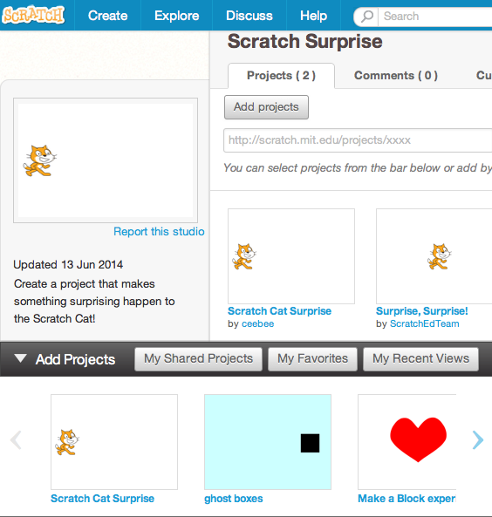
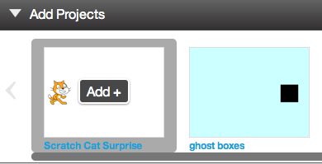
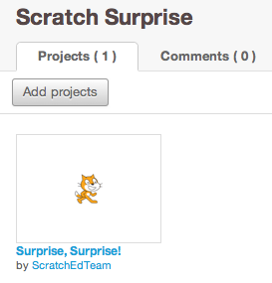
SCRATCH STUDIO
LEARN HOW TO ADD YOUR PROJECT TO AN ONLINE SCRATCH STUDIO!
Studios are collections of Scratch projects. Follow along with the steps below to add your Scratch Surprise program to the Scratch Surprise studio on the Scratch website.
START HERE
Go to the Scratch Surprise studio using this link:
http://scratch.mit.edu/studios/460431
Sign into your account.
Click on “Add Projects” at the bottom of the page to show your your projects, favorite projects, and recently viewed projects.
Use the arrows to find your Scratch Surprise project and then click “Add + ” to add your project to the studio.
Notes:
<numéro>

Slide 14
CRITIQUE GROUP
OBJECTIVES
By completing this activity, students will:
divide into small critique groups in order to give and get feedback on design ideas and works-in-progress
UNIT 0 ACTIVITY
_{SUGGESTED TIME}
15–30 MINUTES
ACTIVITY DESCRIPTION
RESOURCES
Introduce students to the idea of a critique group, a small group of designers who share ideas and projects-in-progress with one another in order to get feedback and suggestions for further development.
Optionally, have the Critique Group handout available to guide students in giving feedback.
Divide students in smaller groups of 3-4 people. In these critique groups, ask students to take turns sharing their ideas, drafts, or prototypes, for example, Scratch Surprise projects.
Let students gather feedback by having their critique group members respond to the Red, Yellow, Green reflection prompts or using the Critique Group handout. Encourage students to record other notes, feedback, and suggestions in their design journals.
Critique Group handout
REFLECTION PROMPTS
RED: What is something that doesn’t work or could be improved?
YELLOW: What is something that is confusing or could be done differently?
GREEN: What is something that works well or you really like about the project?
REVIEWING STUDENT WORK
Did all students have a chance to share their work and get feedback?
NOTES
NOTES TO SELF
It can be valuable to have a dedicated group of peers to give you encouragement and feedback on your design iterations. Provide opportunities for students to continue meeting with their critique groups during Units 1-6.
20
Notes:
<numéro>

Slide 15
CRITIQUE GROUP
PROJECT FEEDBACK
FEEDBACK FOR: ______________________________________________________________________
PROJECT TITLE: ______________________________________________________________________
FEEDBACK BY
[RED] What is something that doesn’t work or could be improved?
[YELLOW] What is something that is confusing or could be done differently?
[GREEN] What is something that works well or you really like about the project?
PARTS OF THE PROJECT THAT MIGHT BE HELPFUL TO THINK ABOUT:
Clarity: Did you understand what the project is supposed to do?
Features: What features does the project have? Does the project work as expected?
Appeal: How engaging is the project? Is it interactive, original, sophisticated, funny, or interesting? How did you feel as you interacted with it?
Notes:
<numéro>

